Slide 1
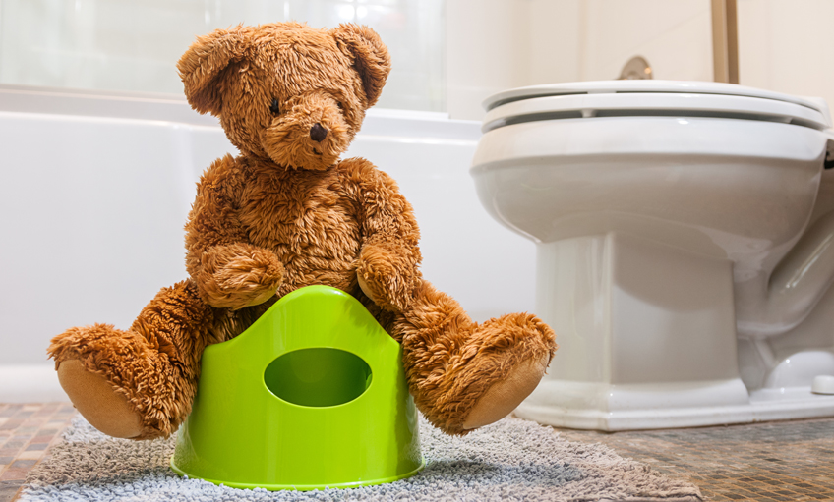
Toilet training

Slide 2
Aim of this session
Learning how to use the potty independently and stopping wearing nappies is a big milestone for your child. There are lots of new and exciting skills for them to learn with your help.
Make you feel more confident toilet training at home.
Give you some steps to follow to help with toilet training.
Explain how we toilet train in Nursery.
Answer any questions you have about toilet training.
Help and advice.

Slide 3
When should you start toilet training?
Before they can start training, your child needs to be given lots of opportunities for learning. Babies are born ready to learn new skills with our help and the best way for them to do so is through practice and repetition.
That's why it's important to think about potty or toilet training in the same way we support children to develop other skills such as brushing their teeth or using a spoon.
Just like when helping them to walk and talk, you can start teaching your child to use a potty before they stop using nappies. This gives them all the time and practise they need to succeed with being independent from nappies when the time comes.

Slide 4
Should we wait for signs of readiness?
ERIC, the Children’s bladder and bowel Charity says that we should not wait for signs of readiness because any children and particularly those with additional needs, will never give any signs that they are ready to potty or toilet train.
The NHS website says that we can wait to see if the children start to show signs of readiness. Some of the signs of readiness are:
They know when they have a wet or dirty nappy.
They may tell you they are weeing or poohing.
The gap between weeing is at least one hour.
They begin to fidget or go somewhere quiet to hide.

Slide 5
What is the best age to start toilet training?
Most children are ready to master potty independence and lead in many parts of the process from around 18 months. The majority of children will be capable of doing most things including wiping by themselves when they start school.
Research shows it is better for your child’s bladder and bowel health to stop using nappies between 18 and 30 months.
The longer you leave it, the harder it can be for your child to learn this new skill and accept not having a nappy on anymore.
Remember that most children can control their bowels before their bladder.
by age 1, most babies have stopped doing poos at night
by age 2, some children will be dry during the day, but this is still quite early
by age 3, 9 out of 10 children are dry most days – even then, all children have the odd accident, especially when they're excited, upset or absorbed in something else
by age 4, most children are reliably dry during the day
It usually takes a little longer for children to learn to stay dry throughout the night. Although most learn this between the ages of 3 and 5, up to 1 in 5 children aged 5 sometimes wet the bed.

Slide 6
How to prepare for toilet training?
The getting ready stage for potty training needs to start early, take time and be a gradual journey you go on together. It can help to think of it as a 'potty learning process' which will pay off in the long run.
Potty learning means helping your child use a potty or toilet as part of their overall learning. Most parents find a good time to start helping their child learn potty skills is from the time they can sit up, usually around 6 - 9 months.
By starting the process early and gently, when the time comes to stop wearing nappies, your child will already have some skills to make this transition easier and less daunting for you both.
It will be a lot less stressful for you both if you tackle potty training as a gradual process, rather than an event that can be completed in 3 days!

Slide 7
Why does potty learning help?
There are 40 different skills your baby needs to learn and put together to become potty trained. You don’t need to wait for them to be able to do all these skills on their own before you start helping prepare them.
Your child has a lot to learn at each stage. This is why it makes sense to do some preparation and practice together before they stop wearing nappies.
Benefits of a potty learning approach include:
You don't need to wait until your child is ‘ready’ and able to do everything on their own before they can start potty learning.
There's no need to wait until your child decides or even tells you they no longer want to wear nappies. Language is one of the very last skills of communication that children develop.
Your child will already have some of the key skills they need to make the move to pants and potty easier when you stop using nappies.
Helping your child learn as they go along, according to what they are capable of at each stage of development, gives them a gentle learning process towards stopping using nappies.
The more practice and help your child gets, the easier it will be when you decide to stop using nappies.

Slide 8
Supporting children with additional needs
Almost all children can learn to be clean and dry. Children with special needs such as delayed speech, autism or a physical disability may find the process more challenging. Children with an additional need often need more support with learning to use a potty or toilet, but we recommend following the same 3 step process: preparation, practice and then stopping using nappies. The longer they wear nappies, the harder it may be to introduce a new place for them to wee and poo. Therefore, it's important not to put off potty training for too long.
Tips to help children with additional needs master toilet training:
Your child may take longer to learn each stage, so consider your expectations and don’t rush the learning.
Focus on one stage at a time. For example, teach them that poo goes down the toilet by flushing it away together.
Be as consistent as possible. The more consistent you are, the easier it will be for your child to learn.
It’s important that your child feels relaxed, comfortable and secure about using the toilet or potty. Make sure the space is accessible to your child. An Occupational Therapist (OT) can help with practical adaptations.
Think about your child's sensory needs and how these relate to using the bathroom. Adjusting the sensory input can make a difference for many children to help them to learn toileting skills.
If you start with the toilet you should use a footstool to help your child feel confident and safe. This will also help your child get into the best position for doing wees and poos, with their feet supported and knees above hips.
Help your child learn the physical skills needed by breaking them down into smaller steps and allowing your child to do the last step independently. For example, help them push their trousers down most of the way, then have them push the last bit down themselves. Same when pulling them up again.
Encourage independence as soon as you see it developing, phasing out support once your child shows competence.
Use stories, visual charts, props and games to teach your child what to do and how to do it. Make your own learning aid by taking photos of your bathroom, drawing pictures of the steps, or by searching on the Internet for visual routines. A standard routine could be: 1.Undress 2. Underwear down 3. Sit 4. Do wee/poo, 5. Wipe, 6. Pull up underwear, 7. Pull up trousers/dress, 8. Flush toilet, 9. Wash hands.
Give your child positive encouragement and praise for the efforts they are making, not just the result. This can help to keep them motivated and willing to move to the next step.

Slide 9
What equipment is needed for toilet training?
A potty (more than one ideally). Choose one that is low to the ground so your child can use it independently. You don’t need to spend a lot of money on anything fancy, it has to do one job well: catch wee and poo!
Some children may prefer to go straight to using the toilet. If this is your child, get a children’s toilet seat and a step stool to help them to feel secure and relaxed. Having feet firmly on the floor or a stool is the ideal position for fully emptying the bladder and bowel.
A travel potty can be helpful when you and your child go out.
Reusable cloth potty training pants are handy if you are travelling or when your child is at nursery. These are like underwear but with an absorbent layer to help soak up accidents which can be washed and used again.
Using a nappy cloth will help your child to understand their body signals. By putting a cloth into your disposable nappy, you can give your child the opportunity to connect to what their body is doing. Being aware that they have weed is the first step to being aware of when they will need to wee.

Slide 10
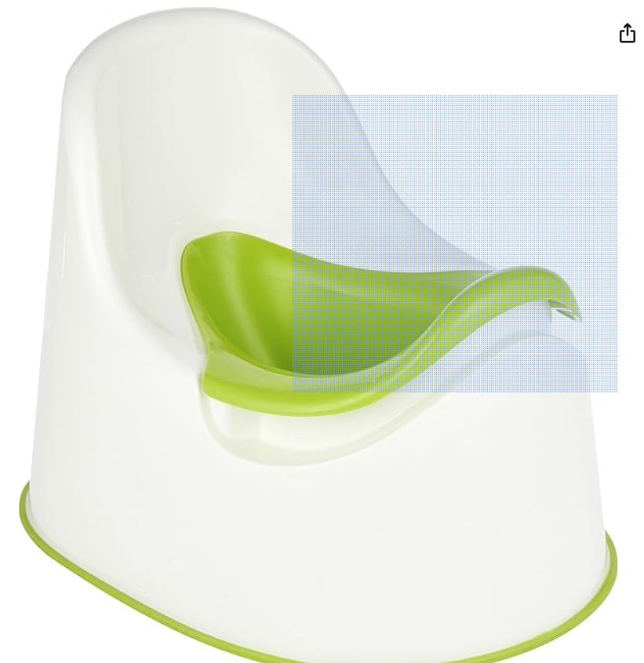
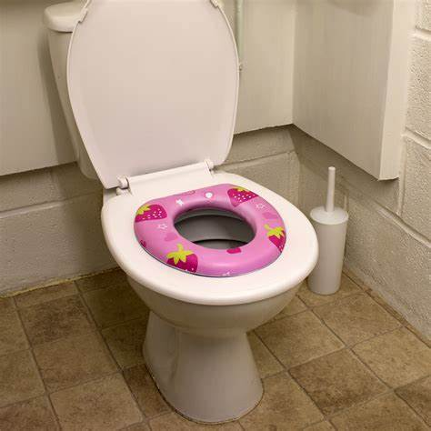
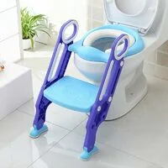
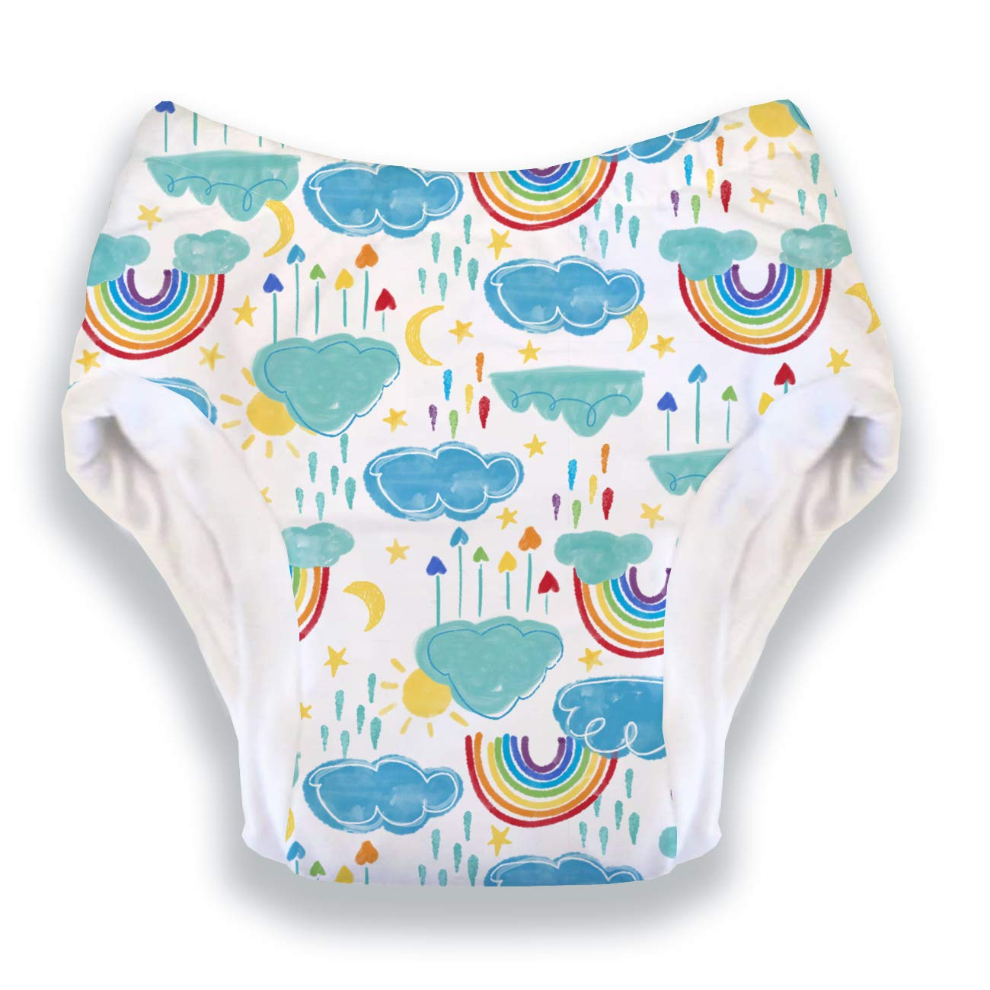
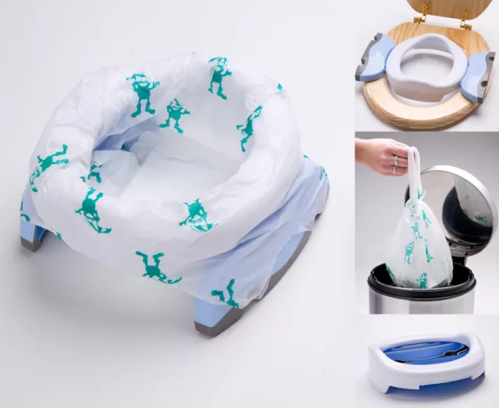
Potty
Toilet seats
Cloth toilet training pants
Travel potty

Slide 11
Step 1: Preparation
Here's how to help your child gain body awareness and prepare them for potty training:
Check that they are passing some soft poo every day and there’s no underlying constipation. If you think your child might be constipated, it's important to sort this out before you stop using nappies.
Make sure they are having plenty of water-based drinks on top of any milk. Keeping their bladder and bowel healthy and working properly will help with potty training.
Try to change nappies or pull-ups as soon as they are wet or soiled. This teaches your baby that it is normal to be clean and dry.
Once they can stand, do nappy or pull-up changes standing up and involve them in cleaning up and flushing poo down the toilet. Talk to them whilst you're doing it so they begin to understand where wee and poo goes and the language we use for the toilet and how our body feels.
Regular, short periods without wearing a nappy or pull-up can help prepare your child for how it will feel when they stop using them completely. Let your child have some nappy of time for up to 30 minutes after they've done a wee or poo. This will help them get used to not wearing it, without having an accident.

Slide 12
Step 2: Practise
From the time your child can safely sit up by themselves, they can start sitting on a potty with your help.
Good times to try a potty sit include:
Shortly after they wake up
After mealtimes
Anytime you know your child needs to go (if you see them straining for a poo for example).
Once you've helped to grow your child's body awareness and they begin to develop confidence in what they've learnt, you can then start to build in and give opportunities to practice some more advanced skills. These include:
Words or signs that they can learn to help communicate their needs to you
How to push their pants down and pull them up again afterwards
Good personal hygiene: the correct way to use toilet paper for wiping, handwashing and drying
Don't forget at this practice stage they can still wear a nappy, but it will boost their capabilities and awareness if they have some nappy free time and potty sits.
Dress them in loose fitting trousers during these periods rather than pants as they may confuse this with wearing a nappy.

Slide 13
Why is feeling comfortable on the toilet important?
Teaching your child how to use a potty and feel comfortable around wee and poo gives them a gentle journey towards being independent from nappies. It also helps avoid many common potty training problems in the future.
Talking about wee and poo when you change them and letting them see you use the toilet gives your child the message that it's a normal part of life and nothing to be afraid of.
Make sure you always use positive language about the wee and poo your child passes – don’t describe poo as ‘smelly’ or ‘stinky’.
There may be times when it is more difficult for you to help your child use a potty or the toilet, for example if they are unwell or if they refuse to cooperate.
Try to stay calm and not put pressure on yourself or your child. It's fine to only do what feels manageable for you both - it's all part of their learning process. You don’t need to abandon potty practice, just pause until your child is feeling better or more willing.
Keep the potty around, and talk about wee and poo when you're changing nappies.

Slide 14
Helping your child learn through play
Using play can help teach your child what you expect as well as motivate them. You can use stories, characters and toys to explain to your child what they need to do and teach them how to do it.
For example:
Have a favourite doll or toy pretend to use the potty
Use books and pictures to show how things work
Help your child add some stickers to their potty to make it their own
Set aside some toys or books that they only look at when on the potty or toilet

Slide 15
Stage 3: Stopping using nappies
Whatever stage your child is on their potty learning journey, stopping using nappies is a big change for them.
Here are some tips to help make this stage easier for you both:
Make sure it’s a good time for you as well as your child. It’s best to avoid doing it at a time when there are any big changes or disruptions to your child’s or family’s routine.
When you are ready, tell your child it is time to stop using nappies. You may like to help your child to say goodbye to their nappies and explain that from now on, they will do all their wee and poo in the potty or toilet.
Make sure your child is drinking enough during the day. Aim for 6-8 drinks a day. Water is the best drink but milk in moderation and well-diluted squash is OK too.
Dress your child in clothes that are easy for them to get on and off, so they can take the lead with using the potty. Some children learn best when they can be at home and naked from the waist down. Other children learn best when they are wearing loose-fitting trousers without pants.
If you have a boy, encourage him to sit down on the potty for both wees and poos especially in the beginning. We empty our bladder better sitting down and it helps to prevent constipation.

Slide 16
Signs your child may need the toilet
They may tell you
They may fidget, go quiet or hide
They may crouch down and start to strain (for a poo)
If you see any of these signs or you know your child needs to do a wee or poo, gently direct them to use the potty. This will increase their chance of success whilst they are still learning how to respond to their body’s wee and poo signals. Doing this helps your child to understand what is expected of them.

Slide 17
Nap times
Once your child has stopped using nappies in the daytime, it’s time to think about nap times.
Learning to sleep without a nappy on at naptime and use the potty when they wake up, will help prepare your child for being dry at night.
Tips for managing nappy-free nap times:
Just before nap time, help your child use the potty or toilet, so they are more likely to stay dry.
When you notice the nappy is staying dry at least some of the time, stop using a nappy at nap time.
Accidents are common during the first few months. Use a waterproof sheet or similar underneath your child, to protect their sleep area.
Lots of children need to use the potty when they wake so help them to do this.

Slide 18
Using praise and rewards to help motivate your child
Research shows that rewards such as sticker charts may help your child initially, but they can stop working quickly.
For most children, encouraging and supporting them to be as independent as possible is the best way to motivate them.
Tips for keeping your child motivated:
Give your child plenty of encouragement and praise their efforts. When your child uses the potty or manages to stay dry, even if it's just for a short time, tell them how pleased you are.
Try to stay calm when accidents happen and do not make a big fuss.
Give your child the opportunity to do things for themselves as far as possible. This will help them to feel in control, positive and relaxed about the process.
Use favourite toys, books or songs to help them feel comfortable on the potty.
Try to avoid prompting or asking your child too often. Instead, wait until you think they need to go and then direct them gently, e.g. “it’s toilet time” or “let’s get that wee/poo in the potty!”
Be clear, confident and consistent so your child knows what you are asking them to do.

Slide 19
Managing toileting accidents
It is normal to have lots of accidents at the beginning and they are an important part of the learning process. This is a big step for your child, so be patient and encourage them.
Tips for managing accidents:
When your child has an accident, clean it up together and remind them to use the potty next time.
Do not shame or punish your child about accidents, as stress and upset can make it harder for you and your child to learn together.
It’s important not to pretend an accident hasn’t happened. Help them get clean and dry as soon as possible and involve your child in this process. Gently explain that you want them to use the potty next time.

Slide 20
Toilet training out and about
When you first stop using nappies, choose a time when you can stay home with your child for a few days, so you can do some one to one learning with them.
Tips to make your first trips out easier to manage:
Don’t forget your potty and spares of everything just in case!
Make trips out short to begin with.
Dress your child in clothes that are easy for them to push down and pull up again.
Avoid putting your child back in a pull up or nappy for outings. This will confuse them and undo all that learning.
A travel potty and washable car seat cover can come in handy.
Using the toilet away from home is a good thing for your child to get used to. Talk to them about things like how the flush at the supermarket is different from the one at home or nursery for example.

Slide 21
Toilet training in Nursery
We take the children into the bathroom and show them the toilets and the sinks particularly the hand dryer as it is very loud and children are often scared of it.
We identify the children who are not toilet trained by asking you. We will create an intimate care plan and ask you to sign this. This plan lists that you are going to provide lots of changes of clothes and underwear and pull ups-no nappies, that nursery will provide gloves, baby wipes and nappy sacks and who is able to change your child. We will clean your child as best as we can. Due to safeguarding procedures we are not allowed to clean around your child’s genitals or in between their bottom. If they are particularly dirty we will phone you to come to change your child yourself.
We take these children into the bathroom on a 1:1 basis and encourage them to pull down their clothing and pull up by themselves. We stay with them and help them with this if needed.
We encourage the children to sit on the toilet. Some children need to be sat on the toilet by a member of staff in the beginning but quickly learn to do this by themselves.
We encourage the children to sit on the toilet for a couple of minutes. If distressed we let them get off the toilet.
After a couple of minutes we encourage them to stand up from the toilet and pull their pull ups and clothing back up by themselves. We stay with them and help them with this if needed.
We take the children into the bathroom every 10 minutes. If the child wees or poos on the toilet we give lots of verbal praise. When the children are ready we increase the time so that it is longer in between toileting visits.
Once the child is dry for the majority of the time in Nursery we stop taking them on a regular basis and we just ask the children if they need to go to the toilet. If we find the children have not been to the toilet for a long time (up to 1 hour) we encourage them to just go to try the toilet.
Once the children can say they need the toilet we stop the prompts all together and the child will go independently.
If your child has a toileting accident we simply change them using the clothes and underwear you have provided. If you do not send in spare clothes we will use the spare clothes in Nursery which you will need to wash and return to Nursery. It is important that you return them as quickly as possible as we do not have lots of spare clothes or underwear in Nursery and this stops us changing a child who needs them. If we do not have spare clothes from yourselves or in Nursery we will phone you to bring clean, dry clothes and underwear for your child.

Slide 22
Common toilet training problems
Taking your time leading your child through the preparation and practice stages should help to avoid the most common potty training problems.
If you feel as though it's all gone wrong and they're just not getting it, it's ok to stop, go back to the preparation stage and start again. You may find that you need to spend longer at one stage and that is OK.
Could they be constipated? Constipation affects 1 in 3 children and is especially common in under 5s. Your child may be struggling because they have some underlying constipation that was there before you started potty training. So stop, treat the constipation and then try stopping the nappies again once it is all under control. Carry on with potty practice – this in itself is an important part of constipation treatment.
Are they drinking enough? Sometime the bladder misbehaves and we realise that our child is simply not drinking enough. Once again, you don’t have to go right back to the beginning, but go back to the potty practice stage while you increase your child’s fluid intake.
Try not to panic if it seems as if they just aren't getting it. Some children take longer to learn, and just need more time.
Reassure your child that their wees and poos will learn to go in the potty, they just need more practice!
If you still have concerns speak to your GP or health visitor.

Slide 23
Help and advice
If you are struggling with toilet training:
Follow the advice on the tips for toilet training sheet we handed out during stay and play sessions and a few weeks ago. If you need these tips again please just ask we have more copies of them.
Speak to your family and friends.
Speak to staff in school.
Speak to your health visitor or your GP.
Phone ERIC, The Children’s Bowel and Bladder Charity
Free helpline: 0808 801 0343 Mon to Thur, 10am - 2pm
Family webinars – ERIC
Home – ERIC
How to potty train - NHS (www.nhs.uk)

